Slide 1
Next-Generation Wireless Bridge Weigh-in-Motion (WIM) System Integrated with Nondestructive Evaluation (NDE) Capability for Transportation Infrastructure Safety
Presenter: Li Dong
CATSS-UTC Symposium, Orlando, FL, Feb 14-15, 2013

Slide 2
Agenda
Introduction of participants
Project background
Objective
Schedule
Progress
Future Work

Slide 3


Participants
Georgia Tech team:
  Dr. Yang Wang (PI)
  Dr. Laurence J. Jacobs (Co-PI)
  Dr. Jin-Yeon Kim (Co-PI)
  Dapeng Zhu (Graduate Student)
  Canny Fang (Graduate Student)
  Kevin Arne (Graduate Student)
UAB team:
  Dr. Nasim Uddin (Co-PI)
  Dr. Hua Zhao (Post-Doctor)
  Dr. Zhisong Zhao (Previous Graduate Student)
  Li Dong (Graduate Student)
  Rahul R Kalyankar (Graduate Student)

Slide 4
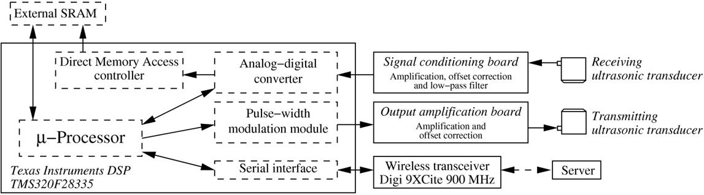
Project Background (GT)
Pertsch, A., Kim, J.-Y., Wang, Y. and Jacobs, L.J. (2011). "An intelligent stand-alone ultrasonic device for monitoring local structural damage: implementation and preliminary experiments," Smart Materials and Structures, 20(1): 015022.

Slide 5
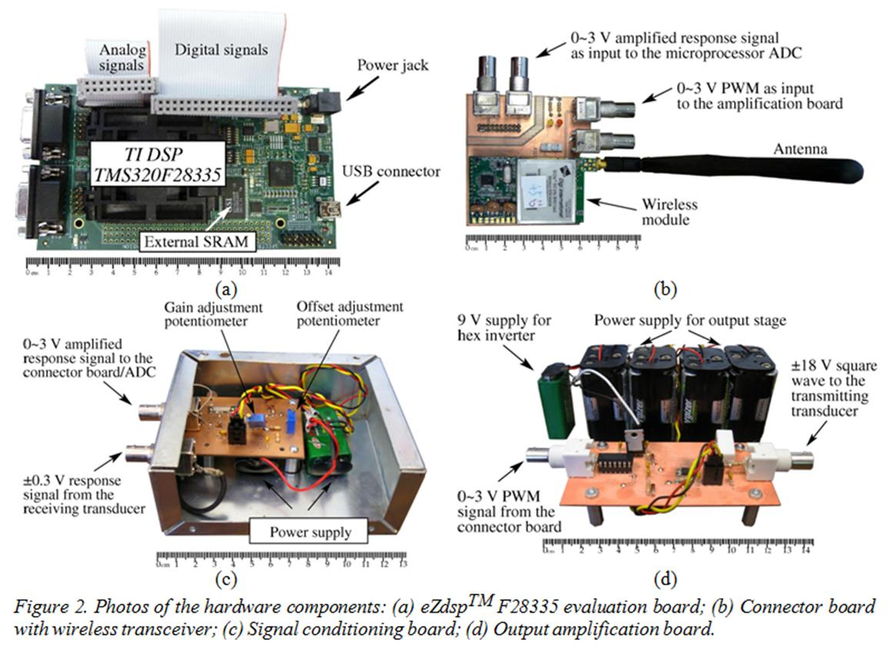
Project Background (GT) cont.

Slide 6
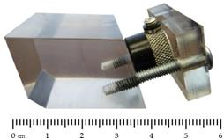
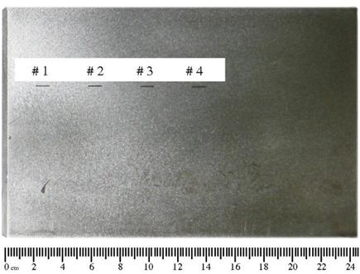
Project Background (GT) cont.
Steel specimen with various notches being detected by wireless ultrasonic device
Diffuse ultrasonic NDE incorporated to wireless device

Slide 7
BWIM shema
Project Background (UAB)
SiWIM Bridge
Weigh-in-motion
system

Slide 8
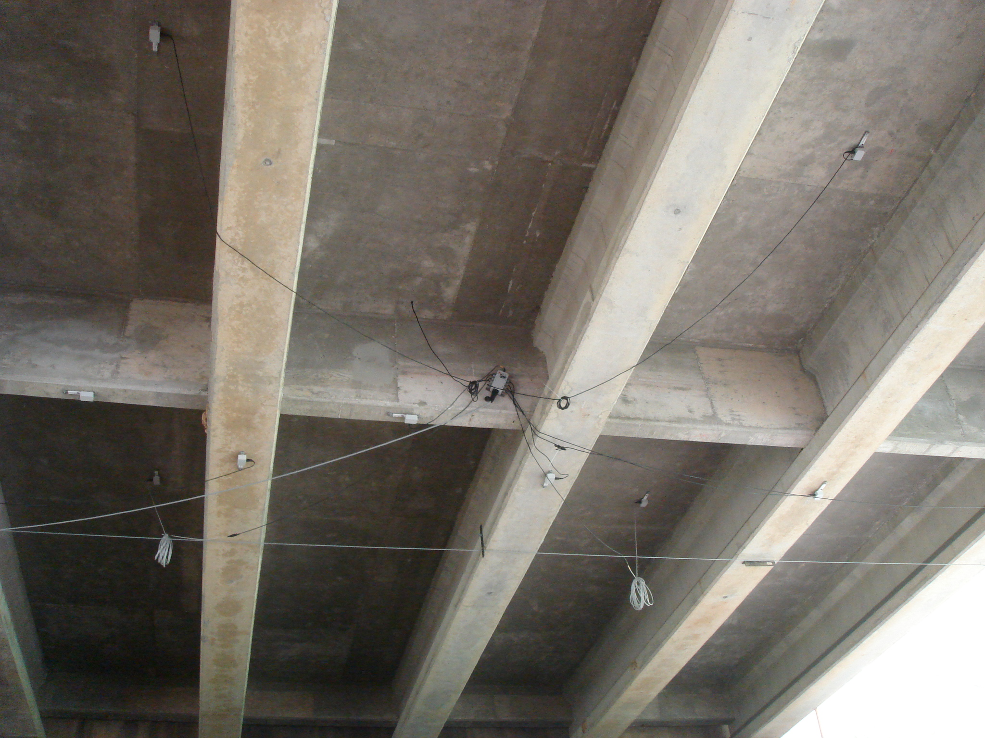
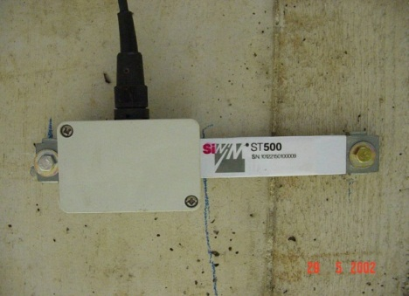
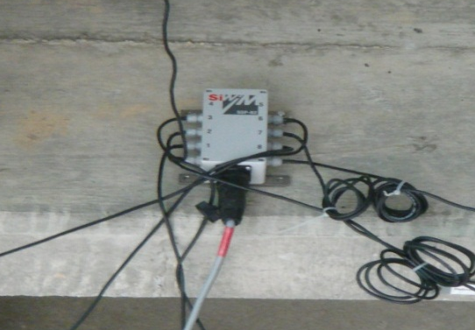
Project Background (UAB) cont.
FAD sensors on slab
Spider
Weighing sensors on girder
B-WIM System Testing on I-459
Notes:
FAD sensors and Spider

Slide 9
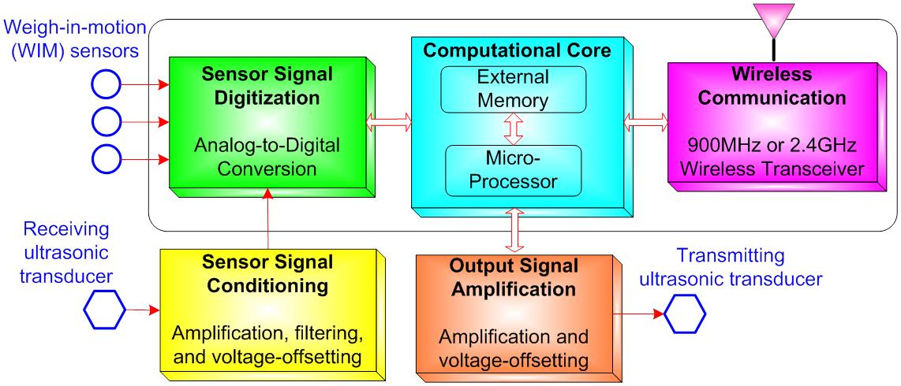
Project Objective

Slide 10
Six-Quarter Schedule

Slide 11
Progress (GT)
Undamaged
Comparison between two sampling frequencies
#1
#1
#2
#2
#3
#3
#4
#4
Amplitude
Amplitude transmission coefficient
0.5mm
1.2mm
2.3mm
3.2mm
undamaged

Slide 12
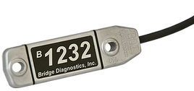
Strain Transducer
Progress (GT+UAB)
Specification | ST350
Gage length | 3 in
Strain resolution | ~1με
Strain range | ±2000με
Price | $455
Circuit | Full Wheatstone bridge with 4 active 350Ω foil gages
Supply voltage | 1~10V
Full-range linearity error | 1%
Sensitivity | 2 (μV/V) / με

Slide 13
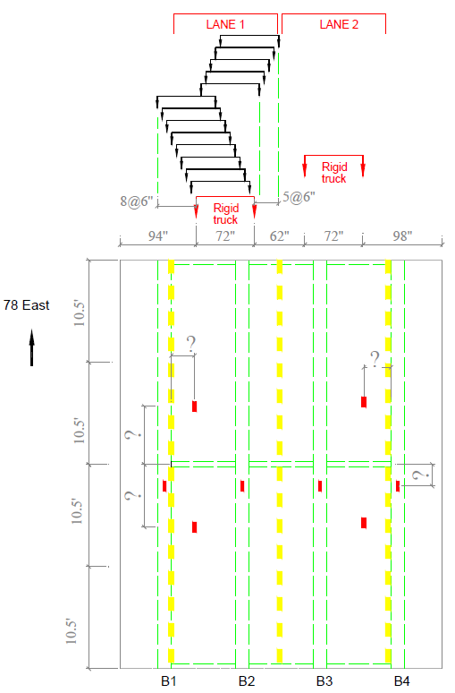
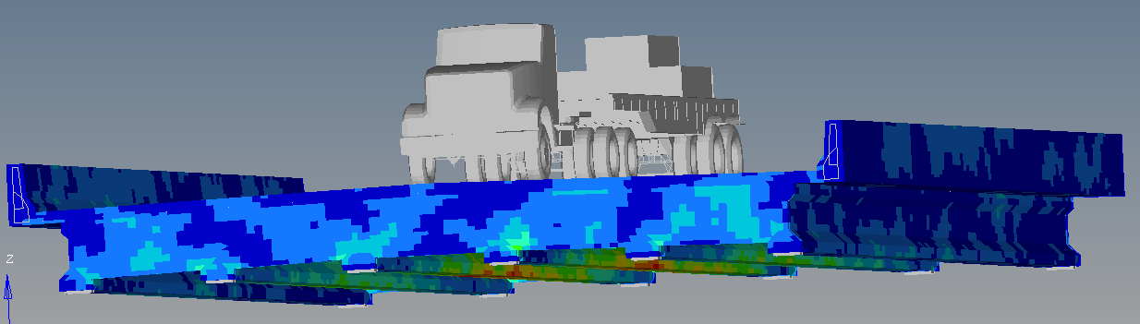
Progress (UAB)

Slide 14
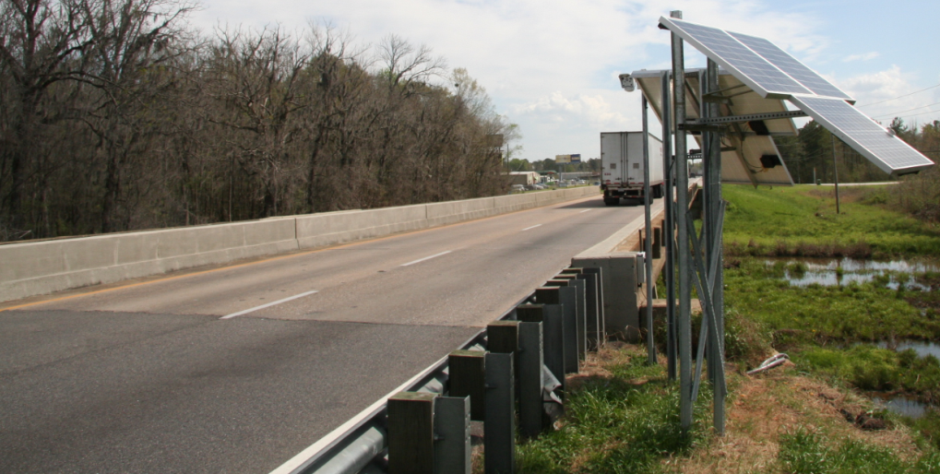
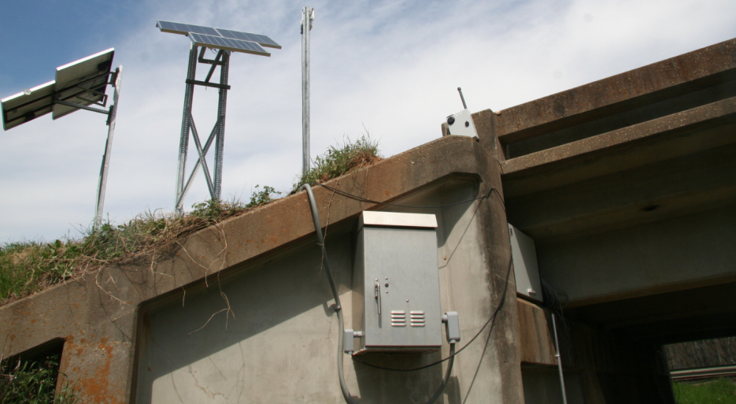
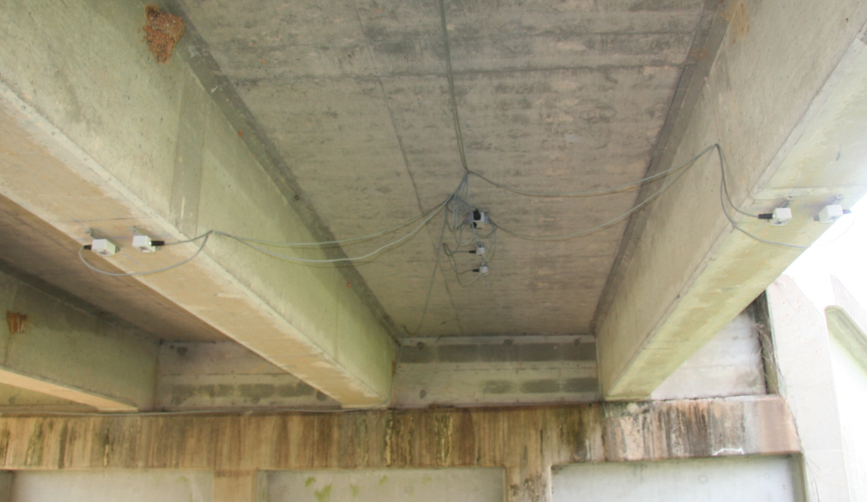
BWIM field test in
Troy Hwy, Montgomery, AL
Future Work

Slide 15
Thank you!
Questions?

